Slide 1

Building Secure Cloud Environments: Practical Tools from Azure and AWS
Juuso Karlström

Slide 2
Contents
CSP’s as Cyber Security Operators
Tooling for Compliance Monitoring and Enforcement
Cloud Security Posture Monitoring
Cloud Workload Protection Platforms
Security Monitoring and Detection
Closing

Slide 3
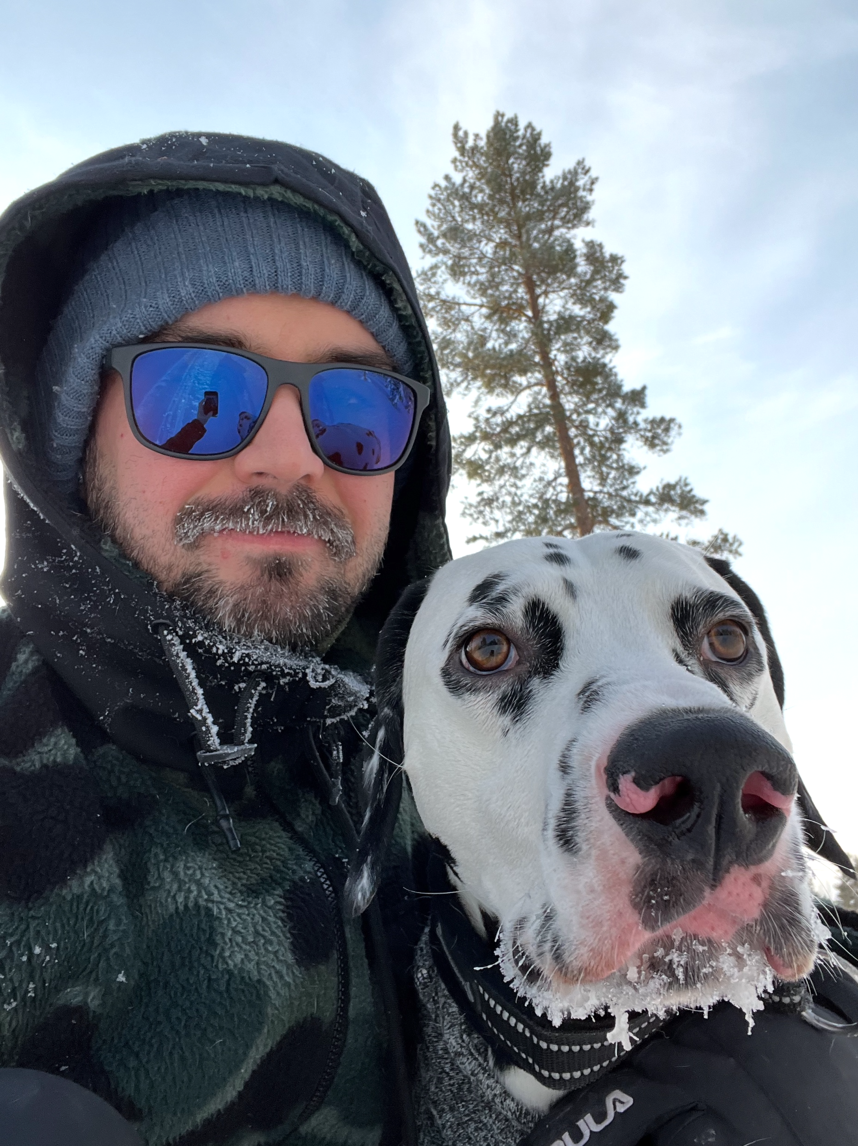
whoami
Juuso Karlström
At OP Pohjola since 2016. Current role Security Solution Architect.
Penetration Tester, Devops Engineer, Product Owner, Cloud Security Engineer.
Working with different cloud platforms since around 2018.
Father of two, husband of one.
Interests and hobbies include playing around with own IAC-projects, homelabbing, and various other projects that I do not ever finish. Muay thai, long walks in the forest, etc.
OUSPG Alumni. OP Tech Academy Mentor.
Education and Certifications
BsC in Information Processing Science
OP Tech Academy Mentor
AWS Security Specialty
AZ-104 Azure Administrator Associate
AZ-500 Azure Security Engineer
AZ-900, SC-900, etc.

Slide 4
Taxonomy
CSP Cloud Service Provider
SCP Service Control Policies (used in AWS)
AWS Amazon Web Services
CSPM Cloud Security Posture Management
CNAPP Cloud Native Application Protection Platform
MCSB Microsoft Cloud Security Benchmark
CASB Cloud Access Security Broker
CIEM Cloud Infrastructure Entitlement Management
CWPP Cloud Workload Protection Platform
MDfC Microsoft Defender for Cloud
AI/ML Artificial Intelligence/Machine Learning
SIEM Security Information and Event Management
SOAR Security Orchestration, Automation, and Response
SOC Security Operations Center
EASM External Attack Surface Management

Slide 5

Introduction & CSP’s

Slide 6

CSP? AWS? Azure? Cyber Security?
Introduction
Cloud Service Provider. Compute with an API. Renting somebody else’s computer. Compute wrapped in different services. Etc. etc.
AWS (Amazon Web Services) founded in 2006. Azure was publicly available in 2010.
CSP’s are acquiring companies left and right to enhance their portfolio
Microsoft acquired Hexadite in 2017 for $100M
Microsoft acquired Aorato in 2014 for ~$200M
Microsoft acquired RiskIQ in 2021 for ~$500M
AWS acquired Harvest.AI in 2016 for $19M
AWS acquired Sqrrl in 2018 for $40M
Google is purchasing Wiz for $32B <- psst this is in the billions
In 2023, Microsoft generated annual revenue of 20 billion US dollars in the cybersecurity sector.

Slide 7
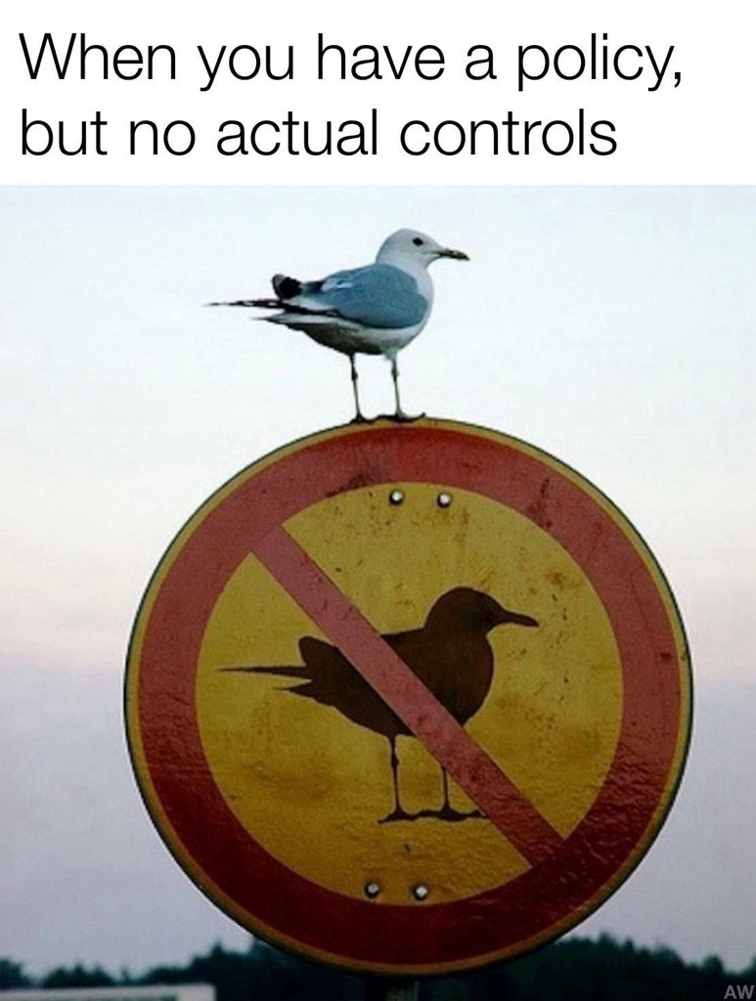
Policy Tooling
Compliancy Management
AWS Config launched in 2014. Additional service Service Control Policies (SCP’s)
An SCP defines a permission guardrail, or sets limits, on the actions that the IAM users and IAM roles in your organization can perform.
Azure Policy was launched around late 2017.
Policies can be of type built-in, Custom, or Self-Attestation
…and have effects of Audit, Deny, Append, Modify, DeployIfNotExists, AuditIfNotExists
Bundle of policies is called a Policy Initiative (or PolicySet)
Both of these services can be used to directly apply different regulatory standards or frameworks to resources, e.g. GDPR, PCI-DSS, etc.
Either AWS Config or Azure Policy can be used as a stand-alone dashboard and a applied to different scopes, or results can also be seen:
AWS Security Hub
Defender for Cloud Regulatory Compliance-dashboard

Slide 8
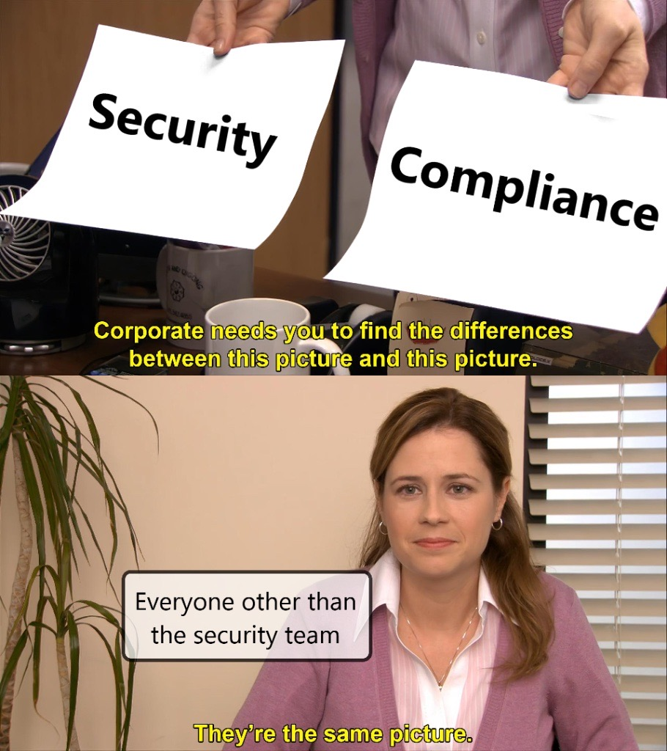
Security != Compliancy | Security == Compliancy
Compliancy Management
Context is Cyber Security. Why are you talking about compliancy and security tooling?
As concepts, they’re closely related but serve a different purpose
Security is about doing the right things to protect your environment.
Compliance is about proving you did the right things according to a defined standard.
E.g GDPR, ISO 27001, SOC 2, PCI-DSS
Case example, using Azure Virtual Machine as the service:
Security: Enable disk encryption and configure Network Security Groups (NSGs) to restrict inbound traffic.
Compliance: Apply Azure Policy to check/apply that all VMs use disk encryption and apply NSG’s for GDPR or ISO 27001.
Interaction: Security protects the VM; compliance proves to auditors that encryption and network restrictions meet regulatory standards.

Slide 9

Cloud Security Posture Monitoring

Slide 10
Security Posture Monitoring 1/3
AWS Security Hub &. Defender for Cloud CSPM
posture
uk/ˈpɒs.tʃər/ us/ˈpɑːs.tʃɚ/
noun
the way in which someone usually holds their shoulders, neck, and back, or a particular position in which someone stands, sits, etc.
Security Posture Monitoring involves continuously assessing, managing, and enhancing an organization's security practices and configurations to ensure compliance with security policies and protect against vulnerabilities and threats in real time.
E.g. “Publicly Accessible S3 Bucket”, “Virtual Machines should have vulnerability findings resolved”, etc.

Slide 11
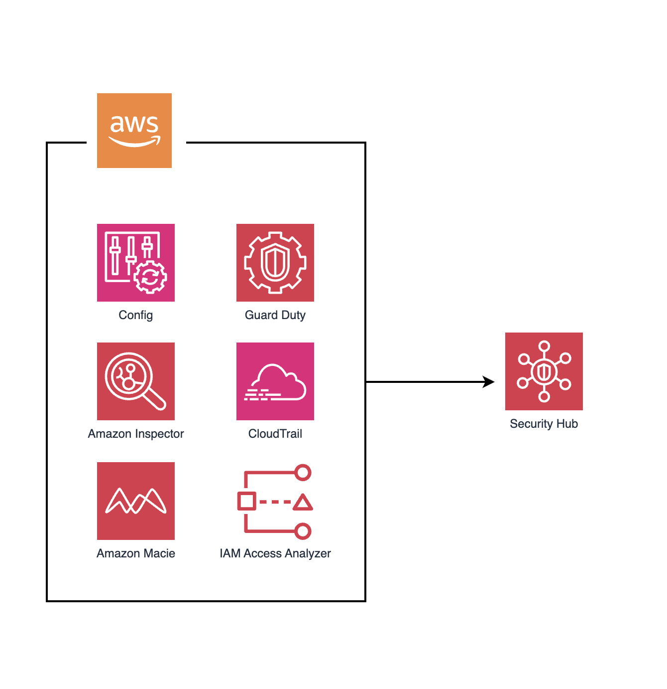
Security Posture Monitoring 2/3
AWS Security Hub &. Defender for Cloud CSPM
AWS Security Hub is a visualisational and operational tool.
Provides a consolidated security score and actionable recommendations for remediation, helping organizations maintain compliance and reduce risk.
AWS Security Hub is the central nervous system for AWS security operations.
With Security Hub, you can directly apply different regulatory standards or frameworks (or via Config)

Slide 12
Cloud Security Posture Monitoring 3/3
AWS Security Hub &. Defender for Cloud CSPM
Defender for Cloud is multicloud and hybrid.
Raises recommendations from Defender CWPP family, MCSB policies, other security related policies, Defender EASM
Building principles: focus on actionable findings with remediation guidance
Automatic Remediation is a hot topic right now, but personally I see it as a flawed with IAC deployment models.
Defender for Cloud CSPM has a lot of resemblance and connections to the Defender CWPP.

Slide 13

Cloud Workload Protection Platform

Slide 14
Cloud Workload Protection Platform
AWS GuardDuty &. Defender for Cloud
CWPP focuses on securing workloads, which include applications and data running on cloud infrastructure. It is designed to protect workloads from threats and vulnerabilities at the application level.
CWPP solutions provide runtime protection, vulnerability management, intrusion detection, and application security. They often include capabilities like vulnerability scanning, network segmentation, and threat detection specific to workloads (e.g., VMs, containers).
GuardDuty and Defender for Cloud CWPP both rely usually on agents being deployed to monitor resources, however the trend is moving towards agentless deployments
Agentless does not deploy agents – how are the resources monitored then for anomalies? How does this effect resiliency?
For Defender for Cloud there are plans should be configured when building a CWPP (Defender for Servers, Defender for Containers, Defender for App Service, etc.) Some plans and features require an agent,
AWS GuardDuty requires a security agent to be deployed to the monitored resource

Slide 15
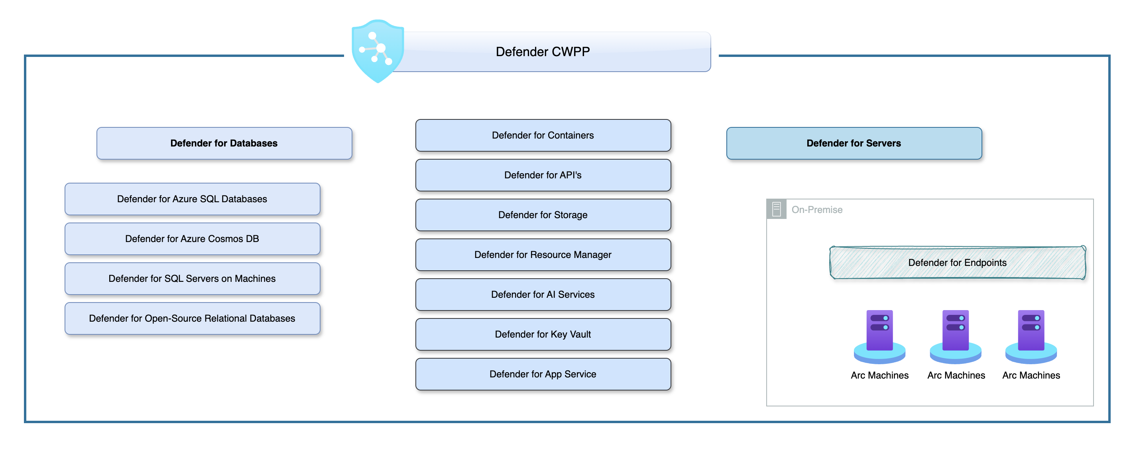
Cloud Workload Protection Platform
AWS GuardDuty &. Defender for Cloud

Slide 16

Security Monitoring and Alerting

Slide 17

Security Monitoring and Alerting (SIEM + SOAR)
AWS GuardDuty vs. Microsoft Sentinel
AWS GuardDuty: Specializes in threat detection for AWS environments by analyzing data sources like CloudTrail, VPC Flow Logs, and DNS logs.
Monitors resources with an agent (usually). Malware Detection for S3’s is agentless.
Microsoft Sentinel: A cloud-native Security Information and Event Management (SIEM) tool focused on providing advanced threat detection and analytics across various data sources, including Azure and on-premises systems.
Sentinel is connected to Defender with service specific connectors.
Differences: GuardDuty highly tied to AWS monitoring (accounts, resources, services). Sentinel is highly integrable to various different sources (SIEM + SOAR)

Slide 18
Closing & Wrapping things up
Summary
With policy enforcement and compliance you can use services like Config or SCP’s in AWS. In Azure, the tool of choice is Azure Policy.
Cloud Security Posture Management is usually a combination of different tools and services, but primary tools are AWS Security Hub and Defender for Cloud
Cloud-native workload protection in AWS could be considered as lacking. In Azure, Defender plans are a plenty with plenty things to configure.
Security monitoring and alerting both CSP’s offer native services. For AWS it is limited to AWS-services only, MS’s offering is multi-cloud.

Slide 19
Thank you! Questions?

